Slide 1
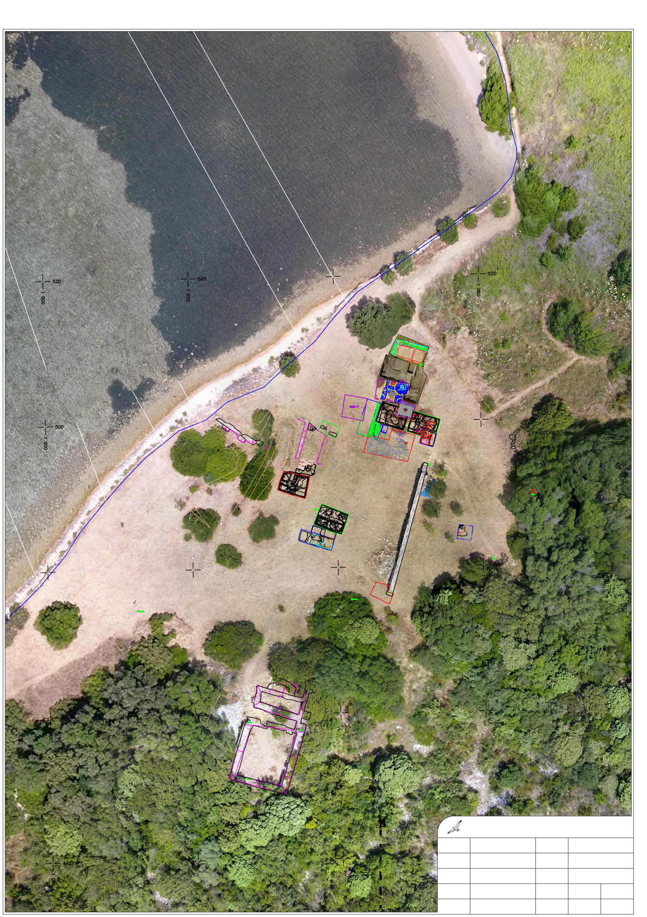
SALT WORKS
PRODUCTION
AREA
NOVAK
PROBES
WALL B
BUILDING A
looking north
SOLINE SITE
DRONE PHOTO and SITE PLAN by P. SAPUNAR
SPLIT, CROATIA, 2018

Slide 2
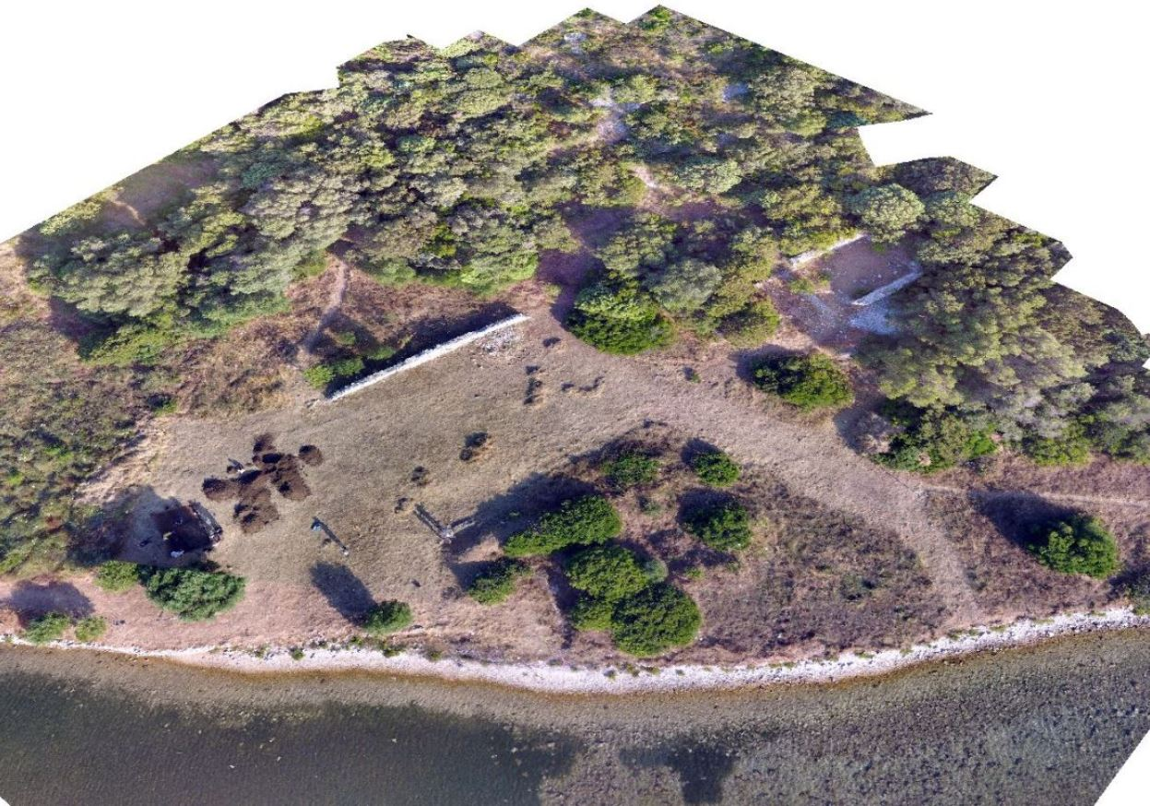
building A
wall B
production area
Novak probes
Soline site looking east 2018 by Emma Rinn

Slide 3
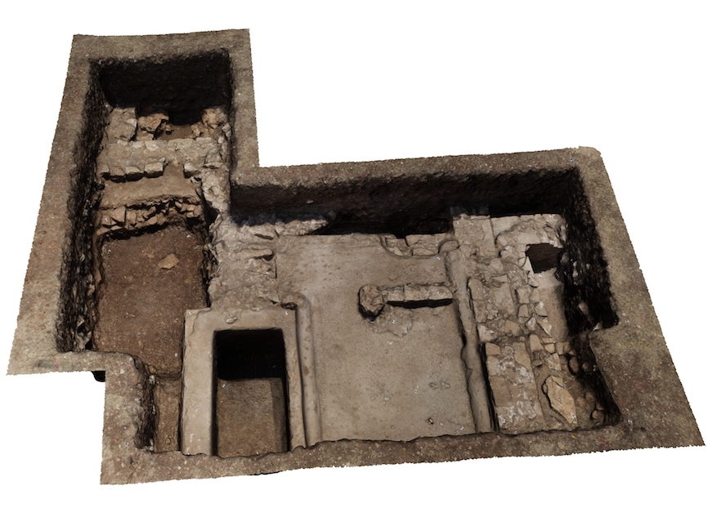
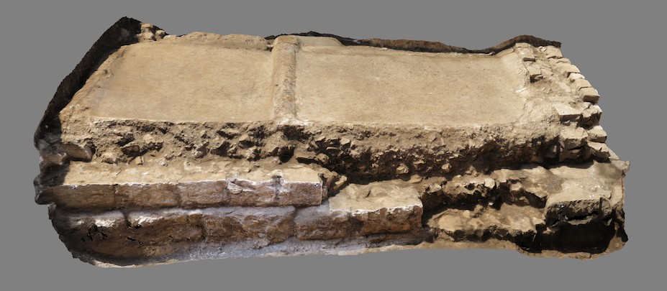
SALT WORKS
BASINS IN THE PRODUCTION AREA, 2017-2018
3D photo by A. Devlahović & S. Popović (upper)
3D Photo by P. SAPUNAR (lower)

